Slide 1

LIFE CYCLE OF WEB REQUESTS
VENKATESHWARAN.M
A MEMBER OF TEAM AURORA
“None of us is as smart as all of us”

Slide 2
What is a Web Request ?
A web request is a communicative message that is transmitted between the client, or web browsers, to the servers. This request is essential in providing the user with the correct and preferred webpages that the server will then display on the user’s interface. The server then retrieves the content requested by the client that will result in the webpages, images or interactive features displayed. Per each request sent on behalf of the client, the server will complete each one thus loading the respective amount of webpages, images or elements.

Slide 3
How Does a Web Request Work?
A web request can also be known as an HTTP request which is the protocol that interacts between the client and the server. A client will type in a URL address prompting the web request to the server. The client or web browser will then connect to the server that it’s seeking information and data from. If the website exists and can be located then the request will continue to be processed. If the website cannot be located, an HTTP 404 “Page Not Found” message will revert back to the client. Once the request has been completed, however, that initial connection has ended and a new one must be made for every additional request made thereafter. Furthermore, within a webpage that has been requested, smaller elements such as visual imagery, videos, or other interactive content will begin to send HTTP requests of their own. Once all requests have been completed for a webpage, the user will be able to interact with all the capabilities and features displayed.
Notes:
This slide is only for the trainer… You can display the poll from GTM and after the poll is taken, share the result, connect the poll result with the topic. Once done, you can hide the poll so that the PPT is visible.
I have created the poll in the GTM webinar.

Slide 4
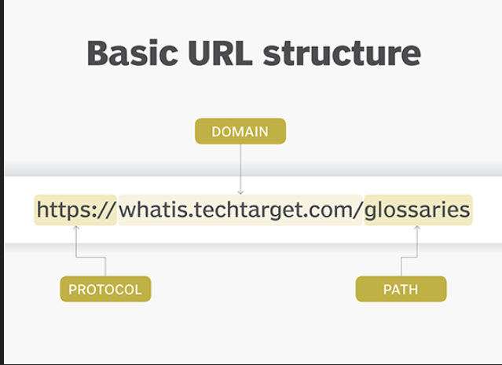
What is a URL?
A URL (Uniform Resource Locator) is a unique identifier used to locate a resource on the Internet. It is also referred to as a web address. URLs consist of multiple parts -- including a protocol and domain name -- that tell a web browser how and where to retrieve a resource.

Slide 5
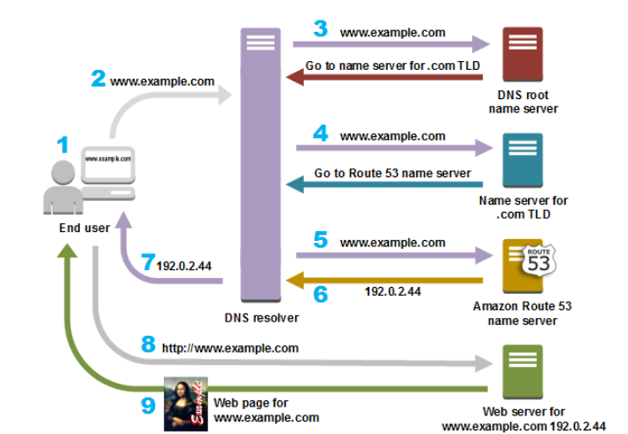
DNS – Domain Name System
Every Http request first contacts a DNS server which resolves the request URL domain to a IP address.
After fetching the Webserver IP address request is forwarded to it(via PUT request). A webserver like apache handles this request and forwards this to application which has to handle this.

Slide 6
Life Cycle Of Web Requests
FLOW
Local Processing
Resolve an IP
Establish a TCP Connection
Send an HTTP Request
Tearing Down and Cleaning Up

Slide 7
Local Processing
Your browser extracts the "scheme"/protocol (we have established
that this will be HTTP), host (www.example.com),
and optional port number, resource path, and query strings that are specified in the form
<protocol>://<host><:optional port>/<path/to/resource><?query>

Slide 8

Resolve an IP
Like the processing done locally, resolving an IP from a "DNS server" is a sequence that includes many steps, and includes failovers if the first request fails to return an address.
If the cache lookup fails (we will assume it does), your browser fires off a DNS request using UDP The DNS request contains the preconfigured IP for your DNS server and your return IP in its header. The hostname for which you are trying to resolve an IP is in the request’s "Question" section. UDP is a lightweight protocol, but the tradeoff is that it offers no guarantees in terms of delivery, and there is no acknowledgement other than a response being sent and received.

Slide 9
Resolve an IP
Your request will now have to travel many network devices to reach its target DNS server. Whenever the packet hits a piece of networking equipment, the device uses a routing table to determine which other device it is connected to that is most likely situated along the shortest path to the destination.
Once your request arrives at your configured DNS server, the server looks for the address associated with the requested hostname. If it finds one, it sends a response. If, on the other hand, the DNS server you have targeted cannot locate the given hostname, it passes the request along to another DNS server it is configured to defer to. This happens recursively until the address is found, or an "authoritative" nameserver is hit. If an address for the given domain cannot be resolved, the server responds with a failure and your browser returns an error.
We will assume the request is successful though, given that all of this is still a precursor. If the response makes it back (remember, with UDP there’s no guarantee!), the requesting client now has a target IP. It will also have received a piece of information as part of the answer that will let it know how long the returned answer can be cached for.
Notes:
This slide is only for the trainer… You can display the poll from GTM and after the poll is taken, share the result, connect the poll result with the topic. Once done, you can hide the poll so that the PPT is visible.
I have created the poll in the GTM webinar.

Slide 10
Establish a TCP Connection
Now that the client has an IP address, it can send an HTTPrequest, right? Almost, but first, since the request is sent over TCP, which is a transport layer protocol like UDP, the client must open a TCP connection.
One of the key differences between TCP and UDP is that TCP ensures delivery and ordered data transmission. Much of this is done very simply, using what’s known as a sequence number for every byte sent. This allows the receiver to re-order received packets back into their original order, and allows the sender to retransmit any packet that does not get acknowledged by the receiver.
These guarantees and more can be found on Wikipedia, and are worth reading about, but what’s most relevant is that TCP connections are opened using what’s known as a three-way handshake. The server must already be "listening" on a port, performing a passive open, after which the client can initiate an active open, and the handshake works as follows:
  The client initiates the active open by sending a SYN "control" packet to the server. The client sets the sequence number for the first packet to a random value purposely, in service of security. We’ll refer to this number as x for now.
  The server responds with a SYN-ACK message, which contains an acknowledgement number for the original message that is always x+1, and a new sequence number for the response itself, which is another random number y.
  In the third step, the client sends an ACK message back to the server with a sequence number equal to x+1, which should match the SYN-ACK message’s acknowledgment number and ensure that our data is being delivered reliably. The ACK message’s acknowledgment number (since it is acknowledging the SYN-ACK) is set to one more than the received sequence number, or y+1.
We now have a completed three-way handshake and an established connection where both the client and server have received acknowledgment of the connection from the other party. The connection has also established a random, sequential sequence for each direction of communication (client->server, server->client), allowing for bidirectional, concurrent communication along the connection, which is also known as full duplex communication.
Notes:
This slide is only for the trainer… You can display the poll from GTM and after the poll is taken, share the result, connect the poll result with the topic. Once done, you can hide the poll so that the PPT is visible.
I have created the poll in the GTM webinar.

Slide 11
Send an HTTP Request
The request is made up of a "request line", request header, and a body. The "request line" is simply a line that indicates the HTTP method, the resource being requested, and the protocol version.The header of the request is made up of pairs in the form name:value <CR><LF> .
Once the HTTP request is sent, it follows a similar routing procedure as the one discussed earlier, with the difference being that using TCPs magic sequence number powers, the server can ensure it receives the whole request, in the correct order.
Once the server receives the request, processes it, and finds the resource being requested, it generates an HTTP response. An HTTP response has a similar structure to an HTTP request, containing a "status line", response header fields, and an optional body. The status line contains an HTTP status code indicating the success, failure, or error-state of the request along with a "reason message" that provides detail.
Once the response is generated, the server responds to the request. At the TCP layer, the client receives the first data packet, the first byte of which should contain the HTTP response header. More packets start coming in, and at the TCP layer they are re-ordered as needed. For every two packets that the client receives at the TCP layer, it sends an ACK message to the server. This goes on until the response is (hopefully) fully loaded.

Slide 12
Tearing Down and Cleaning Up
Once the response has been fully delivered, the client sends a FIN packet at the TCP level, to which the server responds with an ACK, and then generally sends a FIN of its own, which the client responds to with its own ACK signal. The client then waits for a brief timeout, during which it cannot accept new connections, to prevent delayed packets from previous connections arriving during subsequent activities on the port. This four way handshake signals the end of the TCP connection.
At this point, your browser begins processing what it has received. If it is an image, data, or other media file that is being consumed by some application inside the browser, a variety of things can happen. If the data received is HTML, the browser will start parsing the HTML, and rendering the page you requested. As it parses, the browser may come across links to images or other media that are external to the HTML it has received, and will spin up new requests for that content, restarting this whole process (although usually skipping steps 1 & 2 thanks to caching). But, given that we were only interested in the lifecycle of an individual request: our (application’s) work is done, congratulations!

Slide 13
Quick Overview
Steps for what happens when we enter a URL :
Browser checks cache for DNS entry to find the corresponding IP address of website.
It looks for following cache. If not found in one, then continues checking to the next until found.
  Browser Cache
  Operating Systems Cache
  Router Cache
  ISP Cache
If not found in cache, ISP’s (Internet Service Provider) DNS server initiates a DNS query to find IP address of server that hosts the domain name.
The requests are sent using small data packets that contain information content of request and IP address it is destined for.
Browser initiates a TCP (Transfer Control Protocol) connection with the server using synchronize(SYN) and acknowledge(ACK) messages.
Browser sends an HTTP request to the web server. GET or POST request.
Server on the host computer handles that request and sends back a response. It assembles a response in some format like JSON, XML and HTML.
Server sends out an HTTP response along with the status of response.
Browser displays HTML content
Finally, Done.

Slide 14
Q & A
“He or She who asks a
question remains a
FOOL FOR
FIVE MINUTES.
He or She who does not
ask a question remains a
FOOL FOREVER.”

